Slide 1
Lesson 2-
React Application

Slide 2
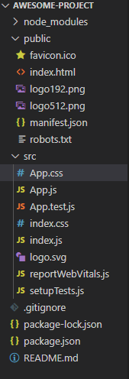
Content of the React Application

Slide 3
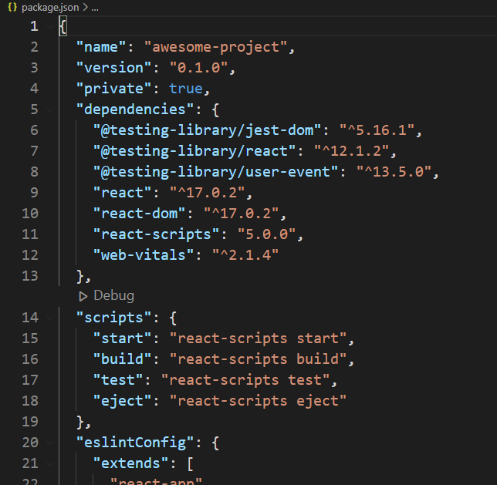
package.json
is the core file representing the project.
Notes:
It configures the entire project and consists of project name, project dependencies, and commands to build and run the application.

Slide 4
react and react-dom are core react libraries used to develop web application.
web-vitals are general library to support application in different browser.
react-scripts are core react scripts used to build and run application.
@testing-library/jest-dom, @testing-library/react and @testing-library/userevent are testing libary used to test the application after developmen
Notes:
The package.json refers the below React library in its dependency section.

Slide 5
public folder
contains the core file, index.html and other web resources
Notes:
- Contains the core file, index.html and other web resources like images, logos, robots, etc., index.html loads our react application and render it in user’s browser.

Slide 6
src folder
contains the actual code of the application
index.js - entry point of our application
index.css - Used to styles of the entire application
App.js - Root component of our application
App.css - Used to style the App component
App.test.js - Used to write unit test function for our component
Notes:
The index.js - Entry point of our application. It uses ReactDOM.render method to kickstart and start the application. The code is as follows:

Slide 7
setupTests.js - Used to setup the testing framework for our application
reportWebVitals.js - Generic web application startup code to support all browsers
logo.svg - Logo in SVG format and can be loaded into our application using import keyword

Slide 8
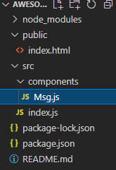
Modify the project
Delete the files that are not needed
Use the figure for your reference
Create components folder under src, then add a new File under it and name it Msg.js

Slide 9
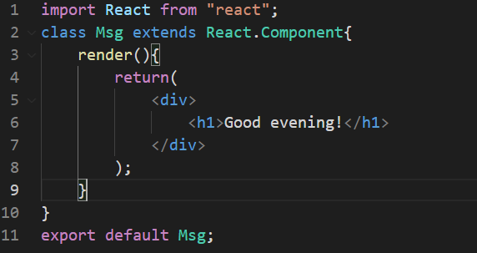
Msg.js

Slide 10
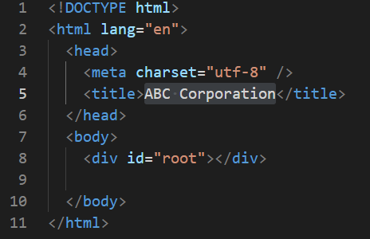
index.html

Slide 11
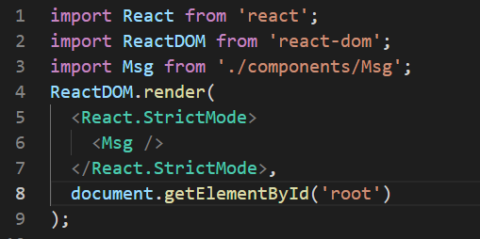
index.js

Slide 12
To run the program, open the terminal window and type npm start
Then check your browser if it is running or not

